Slide 1

Deep Learning with Python
Chapter 3
Book Reading Group
Åke Edlund, Daniel Edsgärd

Slide 2
Session outline – 60 min
(All) 1. Quick summary of the week’s reading, 1-2 slides (5-10 min) - Ake, Daniel
(Groups) 2. Group discussions (5 persons per group) (20 min) - Off-line, group-wise, see below
(All) 3. Walking through the questions, each group presents their findings from their questions. Discussion (~5min/group - total 25 min)
(All) 4. Summary, wrap up, next session (5 min)
Summary, wrap up, next session (5 min)
Note: after session, we will update the wiki and files with above input.

Slide 3
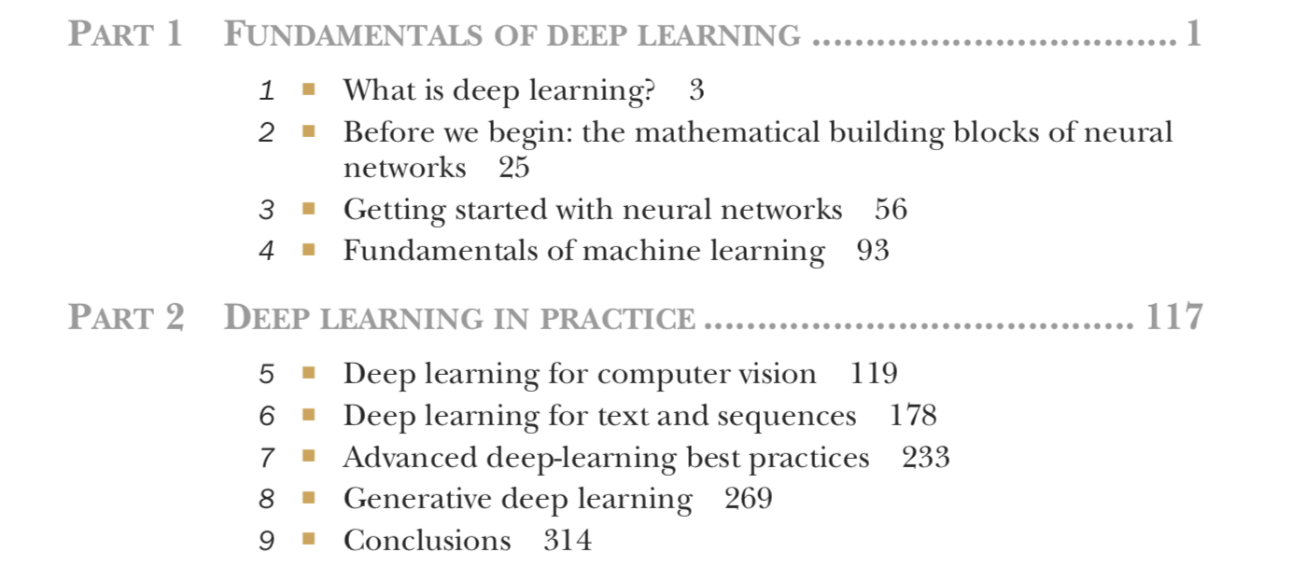
Timeplan
Sep 13 - Chapter 1-2
Sep 20 - Chapter 3
Sep 27 - Chapter 4
Oct 4 - Chapter 5.1-5.2
Oct 11 - Chapter 5.3-5.5
Oct 18 - Chapter 6.1-6.2
Oct 25 - Chapter 6.3-6.5
Nov 1 - Chapter 7
Nov 8 - Chapter 8.1-8.3
Nov 15 - Chapter 8.4-8.6
Nov 22 - Chapter 9

Slide 4
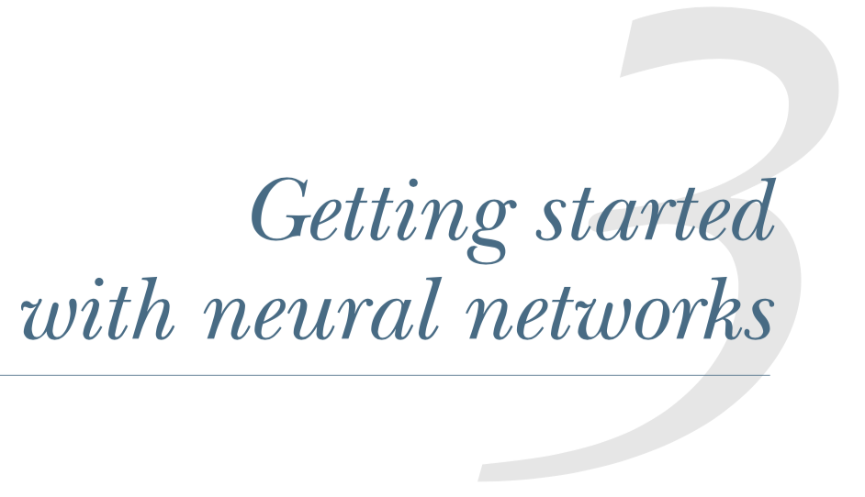
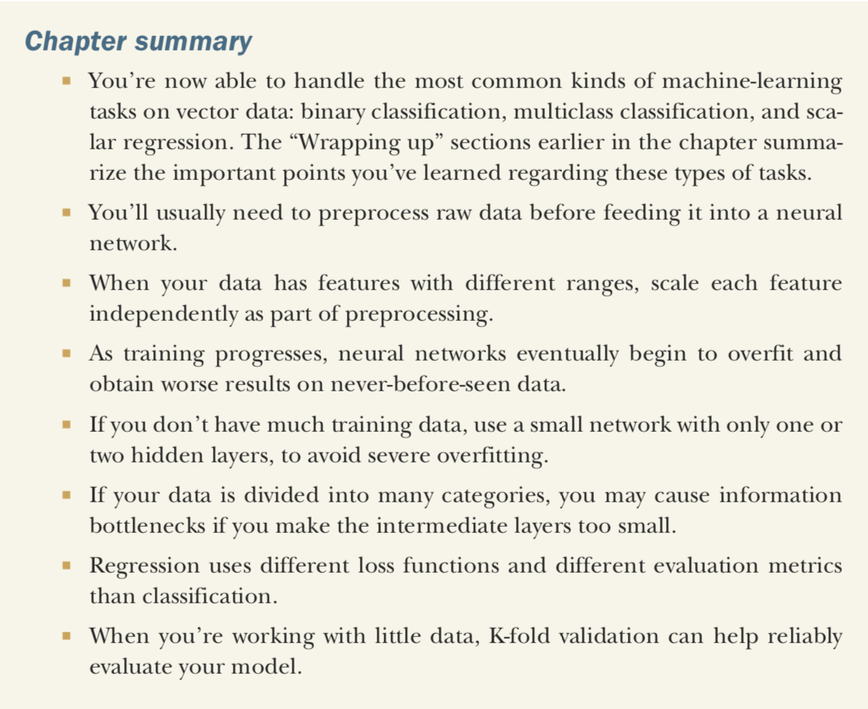
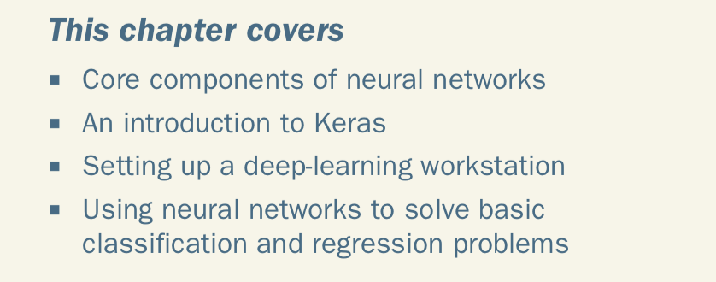

Slide 5
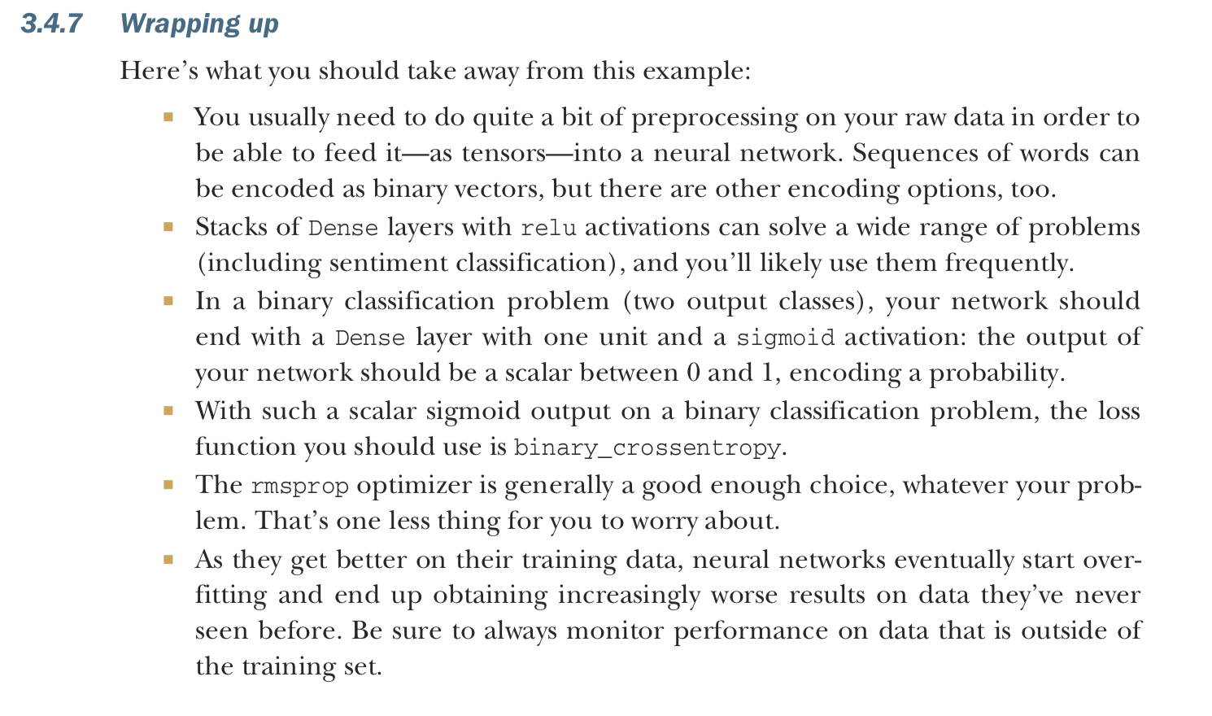
Wrapping ups in text (1/3)

Slide 6
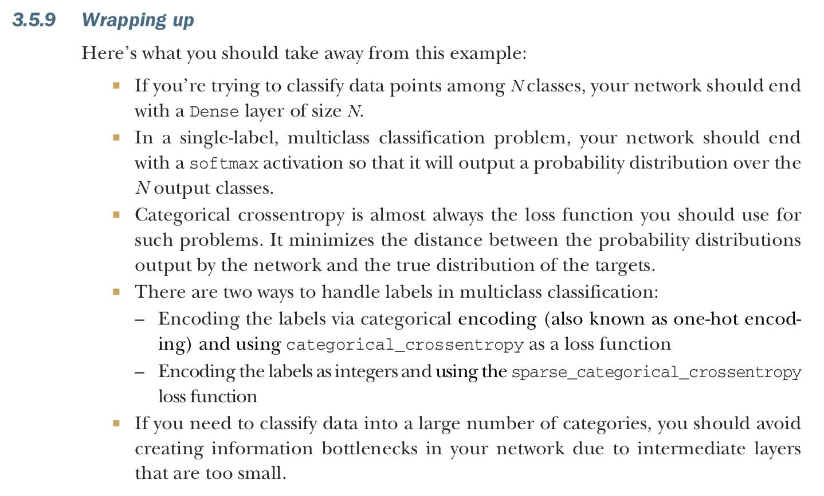
Wrapping ups in text (2/3)

Slide 7
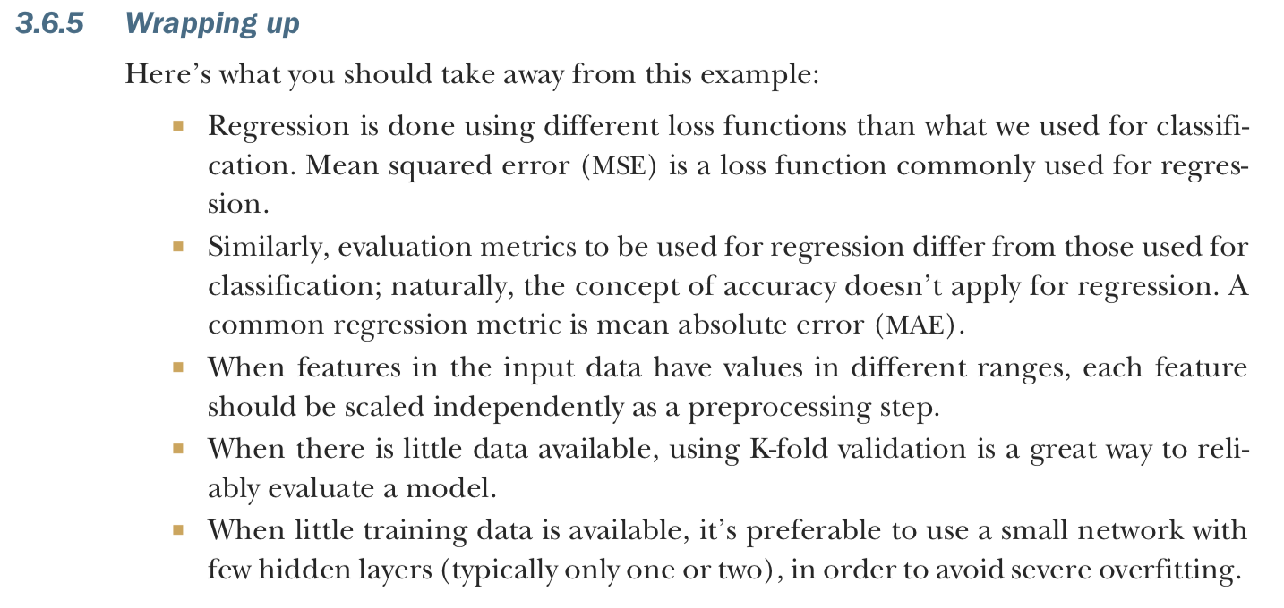
Wrapping ups in text (3/3)

